Slide 1
Networking
Reference Models

Slide 2
Protocol
A protocol is a set of rules that make communication on a network possible
Network communication process is complex
Many functions or steps must be performed to accomplish the task of communication between two networked devices,
  There is generally a protocol for each of these functions
  A complete suite or family of protocols is necessary to do the complete job

Slide 3
OSI Reference Model
The International Standard Organization (ISO) developed a model in which each protocol is a "layer" that performs certain functions for the protocol (layer) above it
The model is referred to as the OSI (open system interconnection) reference model
Does not specify the exact details of each protocol
  It specifies a way of designing protocol suites, i.e., what layers should be present and what functions each layer should perform

Slide 4
Advantages of Layering
It breaks network communication into smaller, simpler parts that are easier to develop.
It facilitates the standardization of network components to allow multi-vendor development and support.
It allows different types of hardware and software to communicate with each other.
It prevents changes in one layer from affecting the other layers, so that they can develop more quickly
It breaks network communication into smaller simpler parts to make learning it easier to understand.

Slide 5
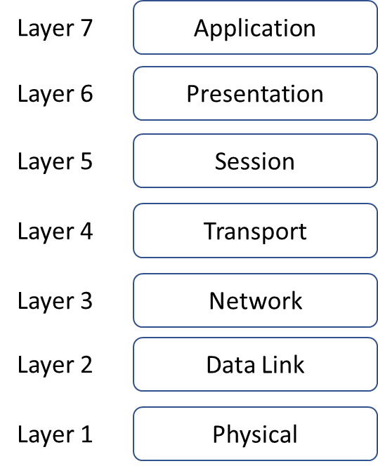
OSI Reference Model

Slide 6
Application
Closest to the user
  It provides network services to the user’s applications e.g. browsers.
It differs from the other layers in that it does not provide services to any other OSI layer
Establishes the availability of intended communication partners, synchronizes and establishes agreement on procedures for error recovery and control of data integrity

Slide 7
Presentation
Data Format
  Make sure the information that the application layer of one system sends out is readable by the application layer of another system
Data Encryption
  Unreadable for 3rd parties
Data Compression
  Reduce the amount of data

Slide 8
Session
The user's interface to the network and contains the software necessary for a user to establish a connection with another computer
The user can then log on and become an interactive user on that machine, or the user can access that machine simply to transfer a file
There should be security mechanisms to protect against unauthorised access to the services or files provided on the network, and there should be mechanisms for graceful recovery from broken connections.

Slide 9
Transport
Interface between the higher application-oriented layers and the underlying network-dependent protocol layers
Provides the session layer with a reliable message transfer facility that is independent of the underlying network type
Segments data from the sending host's system and reassembles the data into a data stream on the receiving host's system
Can provide a reliable, sequenced, error-free transfer facility
May also include some flow control that attempts to prevent faster computers from transmitting data too quickly

Slide 10
Network
Responsible for routing packets from source to destination i.e. selecting the best path
Protocols at this layer provide a global addressing scheme; this is an address that will specify the destination regardless of which combination of transmission links is used
  IP addressing scheme

Slide 11
Data Link Layer
Creates a Frame to carry data and control information
  Error detection / error correction
  Flow control
  Addresses
The assembly and transmission of frames is accomplished by the data link layer
Physical addressing
  MAC or Hardware (as opposed to logical addressing IP)
  Network (logical) topology
  Network media access (CSMA/CD)
Typically implemented in hardware, but the functions of the layers above these are usually implemented in firmware or software

Slide 12
Physical Layer
The physical layer defines the electrical, mechanical, procedural, and functional specifications for activating, maintaining, and deactivating the physical link between end systems
Voltage levels, timing of voltage changes, physical data rates, maximum transmission distances, physical connectors, and other, similar, attributes are defined by physical layer specifications
  Cables
  Connectors
  Patch Panels

Slide 13
TCP/IP Suite
Transmission Control Protocol / Internet Protocol
Suite (group or family) of protocols that permit communication across a network
The suite is called after 2 protocols in the suite
  TCP & IP
Other protocols include
  HTTP, HTTPS, DNS, FTP, SMTP
  UDP
  ICMP, ARP

Slide 14
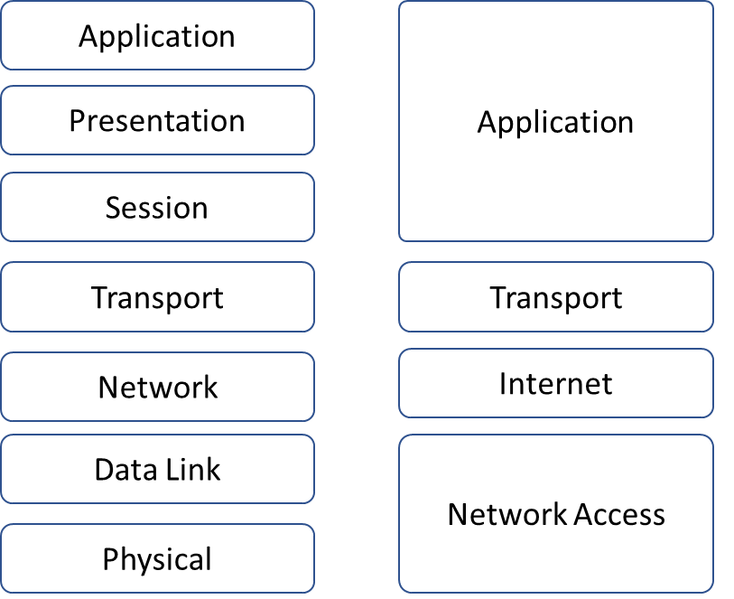
OSI RM v TCP/IP RM

Slide 15
Encapsulation
All communications on a network originate at a source, and are sent to a destination
The information that is sent on a network is referred to as a frame
If one computer (host A) wants to send data to another computer (host B), the data must first be packaged by a process called encapsulation
Encapsulation wraps data with the necessary protocol information before network transit
As the data moves down through the layers of the OSI model, it receives headers, and in some cases trailers

Slide 16
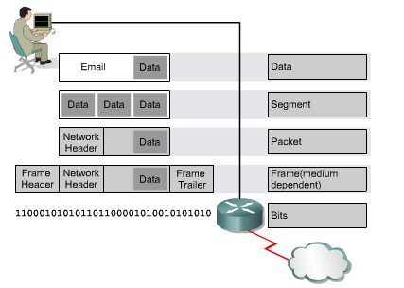
Encapsulation

Slide 17
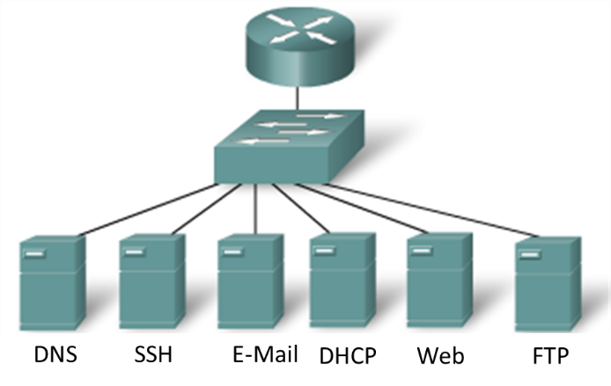
Application Layer Protocols

Slide 18
Application Layer Protocols
Domain Name Service (DNS) is used to resolve Internet names to IP addresses
Hypertext Transfer Protocol (HTTP) is used to transfer files that make up the Web pages of the World Wide Web.
Simple Mail Transfer Protocol (SMTP) is used for the transfer of mail messages and attachments.
Secure Shell (SSH) is a secure application which can provide remote access to servers and networking devices and file transfer.
  Replaces TELNET.
File Transfer Protocol (FTP) is used for interactive file transfer between devices
Dynamic Host Configuration Protocol (DHCP) is used assign configuration information such as an IP address to end devices

Slide 19
Transport Layer - UDP
User Datagram Protocol
  Simple, connectionless, best effort
  Data sent in datagrams
Used by
  Domain Name System (DNS)
  Video Streaming
  Voice over IP (VoIP)
The UDP datagram consists of a UDP header and a block of data
  The header is only 8 bytes and is much smaller and simpler than the TCP header

Slide 20

UDP Header

Slide 21
Transport Layer - TCP
Transmission Control Protocol
  Connection-oriented protocol
  Additional overhead to ensure ordered delivery, reliable delivery, and flow control
Each TCP segment has a minimum 20 bytes of overhead in the header encapsulating the Application layer data. Applications that use TCP are: -
  Web Browsers
  E-mail
  File Transfers

Slide 22
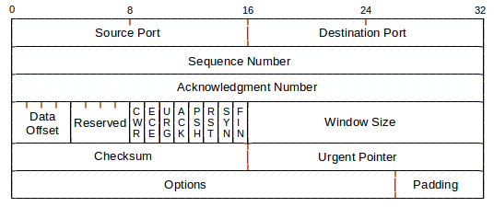
TCP Header

Slide 23
Network Layer Protocols
IPv4
IPv6
Internet Control Message Protocol (ICMP)
  Provides control and testing for the network, for example ping and traceroute

Slide 24
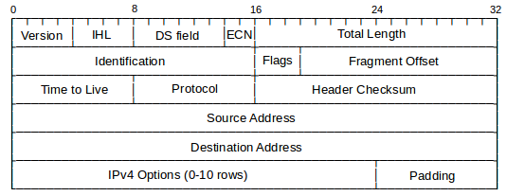
IPv4 Header

Slide 25
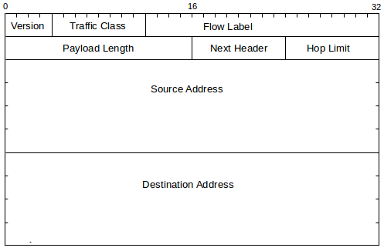
IPv6 Header

